Slide 1
Chongqing University of Technology
ATAI
Advanced Technique of Artificial Intelligence
Chongqing Unive
Directed Acyclic Graph Network for Conversational Emotion Recognition
Code： https://github.com/shenwzh3/DAG-ERC
（ACL-2021)
Reported by Zicong Dou
Notes:
用于对话情绪识别的有向无环图神经网络

Slide 2
Chongqing University of Technology
ATAI
Advanced Technique of Artificial Intelligence
Chongqing University of Technology
1. Introduction
2. Approach
3. Experiments

Slide 3
Introduction
Utterance-level emotion recognition in conversation (ERC) is an emerging task that aims to identify the emotion of each utterance in a conversation.
In this paper, we propose a method to model the conversation context in the form of DAG.
(1)we propose a new way to build a DAG from the conversation with constraints on speaker identity and positional relations.
(2)inspired by DAGNN (Thost and Chen, 2021), we propose a directed acyclic graph neural network for ERC, namely DAG-ERC.

Slide 4
Improvements
Our DAG-ERC has two improvements over DAGNN:
a relation-aware feature transformation to gather information based on speaker identity.
a contextual information unit to enhance the information of historical context.

Slide 5
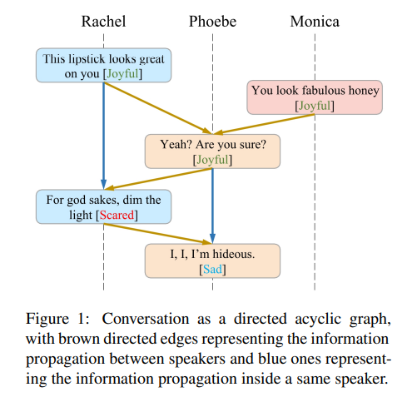
Introduction

Slide 6
Approach
Problem Definition
Three constriants
Design a DAG

Slide 7
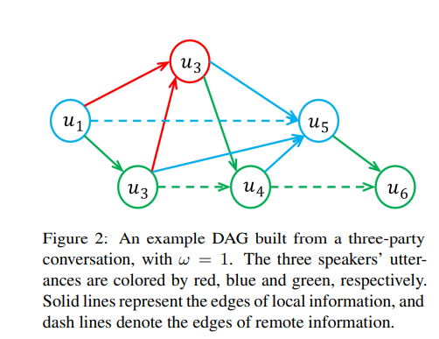
Directed Acyclic Graph Neural Network

Slide 8
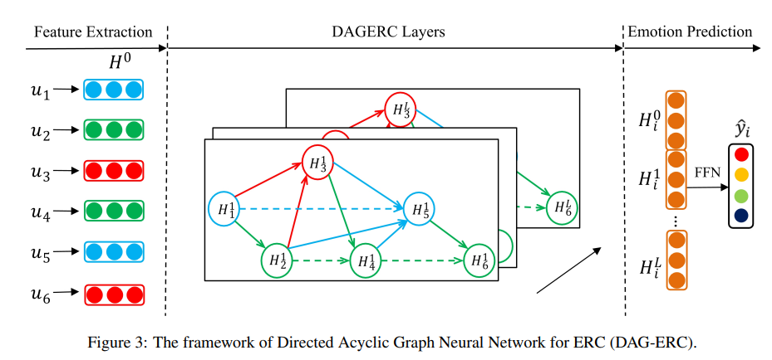
Approach

Slide 9
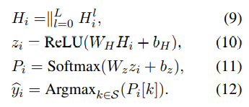
Approach
GNN, RNN and DAGNN
Training and Prediction
DAG-ERC Layers

Slide 10
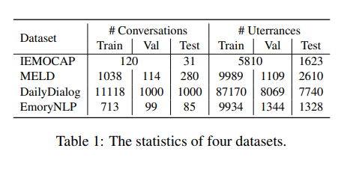
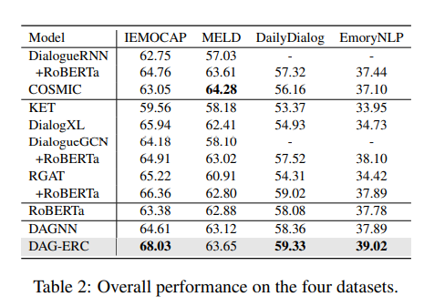
Experiments

Slide 11
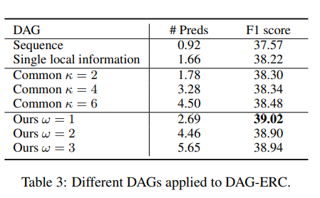
Experiments

Slide 12
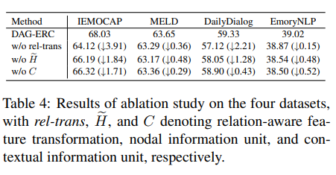
Experiments

Slide 13
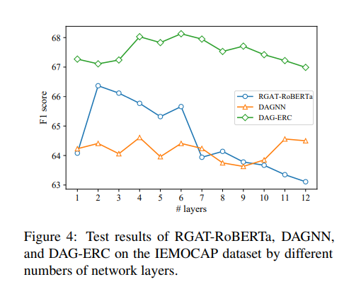
Experiments

Slide 14
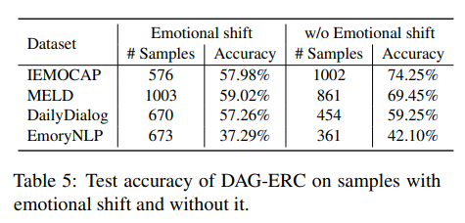
Experiments

Slide 15
Thank you!

